Slide 1
Final Project
IST 718 - Big Data Analytics
Bryan Crigger, Sydney Rickard, Grace Roehrig & Jason Rhodeman

Slide 2
Focus
J
Using already existing datasets, provide an in-depth analysis and decision making process for prospective home buyers.
All Datasets came from Kaggle:
USA Housing Market Factors: https://www.kaggle.com/datasets/faryarmemon/usa-housing-market-factors
Housing Prices Dataset: https://www.kaggle.com/datasets/yasserh/housing-prices-dataset
Business Questions:
What characteristics of a house tend to have the biggest impact on sale price?
Using models, can we predict the price of a home based on these characteristics?

Slide 3
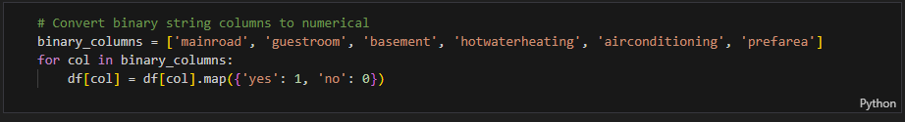
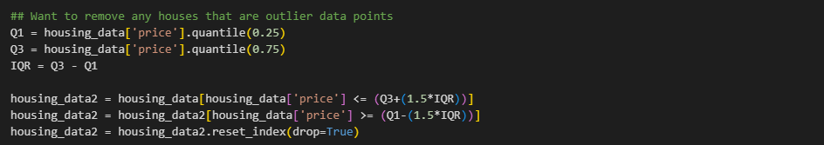
Scrubbing & Modeling
J
For sake of simplicity, all binary columns that provided a “yes / no” answer was changed to a 1 for yes and 0 for no. Simplifying the arithmetic behind the models.
Notes:
Bryan

Slide 4
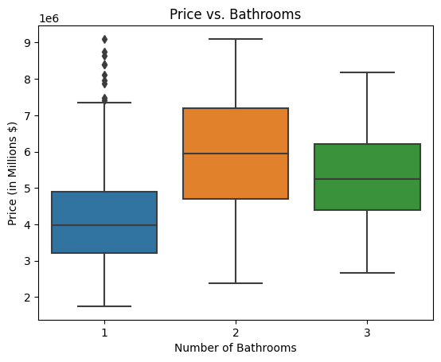
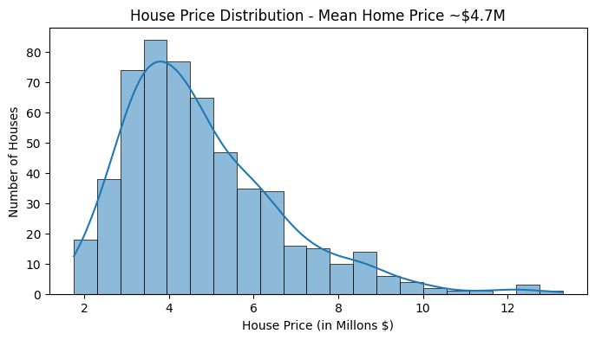
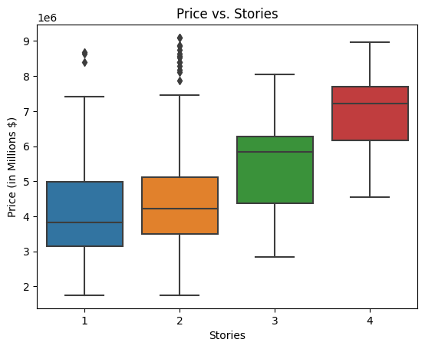
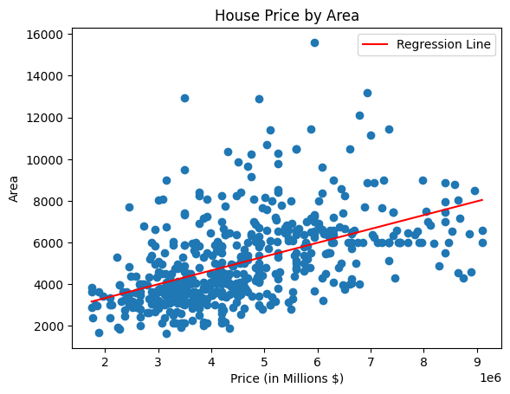
Supporting Visualizations
G
Relationships explored and visualized
Hypotheses

Slide 5
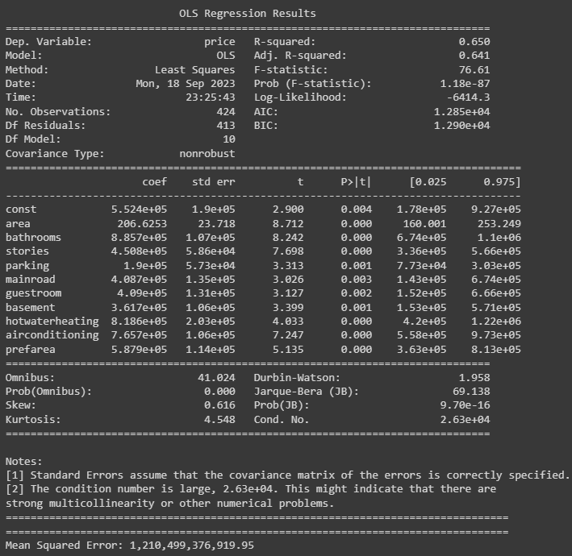
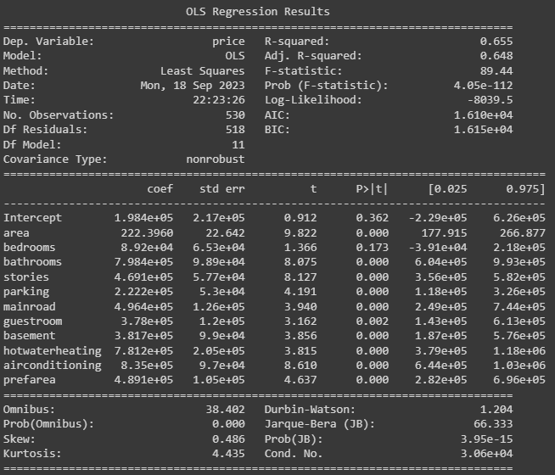
Regression Model
B
Notes:
We tested a handful of regression models
Started with adding in all the variables (R-square value of 0.648)
Trying to improve the model, we removed the variables that had a high P-value and those that had a high VIF score
The best regression model that we were able to get had an adjusted R-square value of 0.641 (which wasn’t as high as we would have liked).

Slide 6
Model- Random Forest & Decision Tree
G
area<=5992.5ft
Area | 0.46162993
Bedrooms | 0.04583879
Bathrooms | 0.17527457
Stories | 0.05318353
Mainroad | 0.01003956
Guestroom | 0.0164316
Basement | 0.03345969
Hot Water Heating | 0.01791422
A.C. | 0.04844253
Parking | 0.05489725
Prefarea | 0.02958393
Furnishing Status | 0.05330439
bathrooms<=1.5
bathrooms<=1.5
Furnishing status<=1.5
area<=4535
bedrooms<=3.5
Bathrooms
<=2.5
$3,254,130
$4,654,944
$5,243,901
$7,257,874
$4,069,085
$6,061,125
$7,052,826
$11,083,333

Slide 7
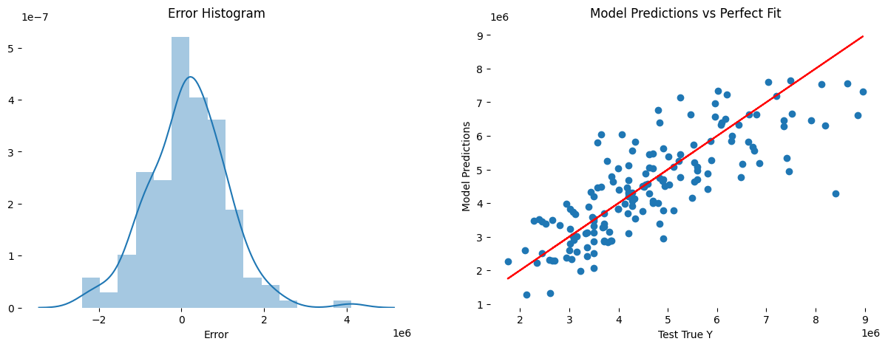
S
Predictions with Keras
Establishes a relationship between our input variables and house price
Predicting house price based on specific tenets of a house
16.5% error on predictions
Features of new house:
area 6450.000
bedrooms 3.000
bathrooms 2.000
stories 1.000
mainroad 1.000
guestroom 1.000
basement 1.000
hotwaterheating 1.000 airconditioning 0.000
parking 0.000
prefarea 0.000
furnishingstatus 1.000
price_in_Ms 5.383
Name: 150, dtype: float64 1/1 [==============================] - 0s 55ms/step
Prediction Price: 5750323.0 Original Price: 5383000.0

Slide 8
Conclusion
J
No model truly captured the goal with complete accuracy. Our group completed additional research during this assignment and were unable to find any models from other sources that had exceptionally accurate predictions for the housing market. Though they can be improved by including more specific data, predicting home price will always be difficult due to constantly changing market conditions and consumer preferences.
Recommendations:
Zillow: move forward with this model as a baseline to continue developing its tool for prospective homebuyers, gather more data and further explore the relationship between house price and area
Buyers and homeowners: keep in mind that square footage will usually be the largest driver of value in their home
This means that their budget will greatly affect the size of home they can afford
if they are looking for a long term investment opportunity, they can buy a home with a sizable square footage and add upgrades later as the area of the home will continue to drive its value.

